Slide 1

Network Programming in Python
Lecture 07
Python 网络编程
讲师: 胡伟通
School of Cyberspace
Hangzhou Dianzi University
2024-2025 Academic Year – 1st Semester
November 2024

Slide 2
「 Week 09-11 」
Network Data and Network Errors
Supplement: Protocol design related

Slide 3

About this course
5.0 Simple TCP/IP service & simple dictionary query service
5.1 Bytes and Strings
5.2 Framing and Quoting
5.3 Pickles and Self-delimiting Formats
5.4 XML and JSON
5.5 Compression
5.6 Network Exceptions

Slide 4
5.0 Simple TCP/IP Services
1. Simple TCP/IP Services
Echo
Daytime
Discard
Char Generator
Quote of the Day
2. Simple Dictionary Lookup Service

Slide 5
Echo Service
Echo Service - The data sent by the client to the server, the server will send it back to the client.
TCP Echo Service - The client actively closes the connection to indicate that the service is no longer needed.
ECHO UDP Service

Slide 6
Daytime Service
The TCP/IP standard defines an application protocol that allows the user to obtain the date and time of the day. The service is officially named DAYTIME service.
Daytime Format:
Weekday, Month Day, Year Time-Zone Example：Tuesday, February 22, 1982 17:37:43-PST
dd mmm yy hh:mm:ss zzz Example：02 FEB 82 07:59:01 PST
Notes:
在TCP/IP标准中定义了一个可以允许用户获取当天的日期和时间的应用协议，得到的日期和时间是用户能读懂的格式。该服务被正式命名为DAYTIME服务。
对于daytime没有特定的格式，建议使用ASCII可打印字符，空格和回车换行符。daytime应该在一行上。

Slide 7
The standard states that DAYTIME can be obtained via TCP or via UDP.
TCP-based DAYTIME service
The TCP version of the DAYTIME service uses the presence of a TCP connection to trigger the output: the server listens on TCP port 13, returns the ASCII date and time as soon as the connection is established, and closes the connection after the transfer. Received data is ignored.
UDP-based DAYTIME service The UDP version of the DAYTIME service requires the client to send a request. The request is an arbitrary UDP datagram. As soon as the server receives a datagram on port 13, it formats the current date and time and sends a datagram back to the client. The data received by the server is ignored.

Slide 8
DAYTIME UDP Service
DAYTIME TCP Service

Slide 9
Simple dictionary query service
Design a dictionary query service protocol, the client sends a query to the English word to the server, the server sends the corresponding Chinese meaning to the client, and the client displays the meaning of the Chinese.
dictServer -p 5150 127.0.0.1
dictClient -p 5150 127.0.0.1
abacus
n．算盘
abandon
v．n．放弃，放纵
quit

Slide 10
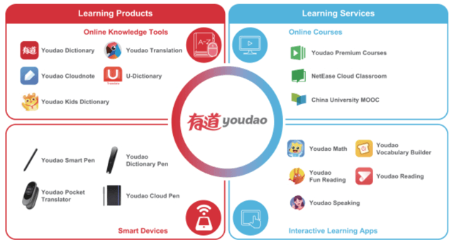


Simple dictionary query service
Youdao (DAO) has filed to raise gross proceeds of $300 million from a U.S. IPO, according to an F-1 registration statement.

Slide 11
Existing Problem
TCP is a stream-based protocol
Deep understanding of the socket.recv() function.
How to reach an agreement that both sides understand?
HTTP
FTP
POP3
SMTP

Slide 12
Design 1: Special Character Boundaries
Network programs need to have a mutual understanding agreement when communicating
The easiest way is to answer one word (one person, one sentence)
A sign ending with a newline character (’\r\n’) as a party
How to read this sentence?
Implement a function like readline
Option 1: One character, one character read
Option 2: Read a batch of data at a time
dict_tcp_client2.py dict_tcp_server2.py

Slide 13
Design 2: fixed length message
Use fixed length packet length
In the dictionary server, assume：
Request and response packets are of fixed length ：100 bytes
Implement a function like readn
dict_tcp_client3.py dict_tcp_server3.py

Slide 14
Design 3: length prefix
Add a length prefix in front of the packet
Fixed length prefix, indicating the packet size that follows.
The prefix is in text form. Length？
The prefix is in binary form. Endian？
Use struct library
Network byte order
dict_tcp_client4.py dict_tcp_server4.py
dict_tcp_client5.py dict_tcp_server5.py

Slide 15
5.1 Bytes and Strings
（1）Byte
Computer memory chips and network cards both support the byte as their common currency.
So, now let us consider the properties of bytes.
A bit is the smallest unit of information. It is a digit that can be either zero or one. In electronics, a bit is often implemented as a wire whose voltage is either hot or tied to ground.
Eight bits together make a byte.
Notes:
字节（Byte）是计算机信息技术用于计量存储容量的一种计量单位，通常情况下一字节等于八位比特，也表示一些计算机编程语言中的数据类型和语言字符
（二）“字符”的定义
字符串主要用于编程，概念说明、函数解释、用法，字符串在存储上类似字符数组，所以它每一位的单个元素都是可以提取的，如s=“abcdefghij”，则s[1]=“a”，s[10]="j"，而字符串的零位正是它的长度，如s[0]=10，这可以给我们提供很多方便，如高精度运算时每一位都可以转化为数字存入数组。
（三）字节串是存储字符的数字单位,字节串是不可改变的序列,字节是0~255之间的整数，可以写为：b'hello'，不能写为b'你好’
字符串是普通的字符组成的，比如: “hello”,“你好”等字符串(string)是由数字、字母、下划线组成的一串字符
讲一下显示器上的1比特。RGB三原色。

Slide 16

5.1 Bytes and Strings
The researchers performed the task with a chip consisting of only 53 qubits, the quantum version of the bits found in everyday computers. “It’s fascinating that we can do something so powerful with such a small chip,” says quantum physicist Mária Kieferová of the University of Technology Sydney, who was not involved with the study.

Slide 17
5.1 Bytes and Strings
（2）Character Strings
If you really do want to transmit a string of symbols over a socket, you need an encoding that assigns each symbol to a valid byte value. One of the most popular encodings is ASCII.
>>> for i in range(32, 128, 32):
... print(' '.join(chr(j) for j in range(i, i+32)))
...
! " # $ % & ' ( ) * + , - . / 0 1 2 3 4 5 6 7 8 9 : ; < = > ?
@ A B C D E F G H I J K L M N O P Q R S T U V W X Y Z [ \ ] ^ _
` a b c d e f g h i j k l m n o p q r s t u v w x y z { | } ~
（3）Socket sending/receiving data:
Communication strings: encoding & decoding
（4）Encoding methods:
Single-byte encodings & multibyte encodings
Notes:
（四）用套接字传输：网络通信中字节的一个特点是，套接字接口将字节暴露了出来，使得其无论是对程序员还是对应用程序都是可见的。我们通常无可避免地要考虑在传输过程中表示数据的方式。这会给我们带来一些问题，而Python这种高级语言是可以让我们避免这类问题的。
（五）用套接字传输一个符号串
如果想用套接字传输一个符号串，就需要使用某种编码方法。从而给每个符号分配特定的值。
一般流行的就是ASCII编码方式，现在Python3之后，Python把字符串看作是由Unicode字符组成的序列。就和Python的数据结构一样，我们不需要考虑字符串的内部实现，传输时省心了，但接收时需要仔细。
（六）编码方式也分为两大类:单字节编码和多字节编码…
前者即每个字符与字节的值唯一对应，后者中每个字符可能会用多个字节来表示。
由于在一些多字节编码方式中，用于表示不同字符的字节数是不同的，因此操作起来要多加小心。
如果数据流被分割为多个部分，那么我们就不知道某个字符是否由于位于分割边界而从中间被分开。
此时对部分接受的信息进行解码是很危险的

Slide 18
5.1 Bytes and Strings
Binary Numbers and Network Byte Order
We describe the difference this way: some computers are “big-endian” and put the most significant byte first, just like we do when writing decimal digits; other computers are “little-endian” and put the least significant byte first (where “first” means “at the byte with the lower memory address”).
Some suggestions for using Python “struct” package：
When using struct-module to generate binary data for network transmission, the receiver should use struct-module to decode after receiving it.
If you want to control the format of the data transmitted over the network, use the Prefix !.
little-endian: (denoted by < )
Be sure to test when using struct-module
Notes:
如果只想通过网络发送文本，那么只需要考虑，编码与封帧问题。如果使用更紧凑的格式来表示数据，我们编写的Python代码就要注意另外一个问题，网络字节顺序。
一般解决方法有两种，大端法和小端法。（有点类似于姓和名的摆放顺序不同。演示C++代码，鼓励输出内存地址看看）
这里可以用Python的struct模块来看一下具体区别.一般来说，会有下面的建议：
利用struct模块生成用于网络传输的二进制数据时，接收方收到后用struct模块解码。
如果要自己控制网络传输的数据格式的话，在选择网络字节顺序时使用！前缀。
如果其他人设计了协议并使用小端法，那么我们必须使用小字节序(以<表示)。。
使用struct的时候一定要进行测试。

Slide 19
5.1 Bytes and Strings
Bytes and strings in Python：
Code demo

Slide 20
5.2 Framing and Quoting
If a UDP datagram is used for communication, the protocol itself uses a separate, identifiable module for data transmission.
If you use TCP for communication, you have to face the problem of frame closure. That is, how to split the message so that the recipient can recognize the beginning and end of the message. Recv() must be run multiple times to receive the complete packet.
Pattern 1：Simply Send All Data and Then Close the Connection.
Pattern 2：Streaming in both directions.
Pattern 1 variant: Both directions send information by stream, one party sends the request data, then closes the transmission, and the other party starts sending the response. Note: This direction must be turned off after one party has finished sending. Otherwise, it is easy to deadlock.

Slide 21
5.2 Framing and Quoting
Pattern 3：Use fixed-length messages
Pattern 4：Divide message boundaries with special characters
Pattern 5：Prefix each message with its length
Pattern 6：Pattern 4 + Pattern 5
Pattern 4 + Pattern 5: If we want to take advantage of the simplicity and efficiency of Pattern 5, and we can't know the length of the message in advance, we can use Pattern 6. We don't just send a single message, but we will send multiple blocks, and each data block is prefixed with the data block length. When the tail is reached, the sender can send a signal agreed with the receiver in advance to inform the receiver that all data blocks have been sent. (code demo)

Slide 22
5.3 Pickles and Self-delimiting Formats
Pickle is Python's native standard library. It stores the contents of the Python data structure for recombining the data structure on another machine.
>>> import pickle
>>> pickle.dumps([5, 6, 7])
b'\x80\x03]q\x00(K\x05K\x06K\x07e.'
>>> pickle.loads(b'\x80\x03]q\x00(K\x05K\x06K\x07e.blahblahblah')
[5, 6, 7]
The above ends with the . character at the end of the string, which is used to mark the end of a pickle. After encountering, the loader will stop reading and return data immediately. Plus other data, it will be ignored directly.

Slide 23
5.3 Pickles and Self-delimiting Formats
Of course, using load() this way is not useful for network data since it does not tell you how many bytes it processed in order to reload the pickle.
>>> from io import BytesIO
>>> f = BytesIO(b'\x80\x03]q\x00(K\x05K\x06K\x07e.blahblahblah') >>> pickle.load(f)
[5, 6, 7]
>>> f.tell()
14
>>> f.read()
b'blahblahblah’
There is another way to create a protocol. The only content of the protocol is to send pickles in two Python programs.
Notes:
当然还有另外一种方案，就是可以创建一个协议，协议唯一的内容就是在两个Python程序员中发送pickle。

Slide 24
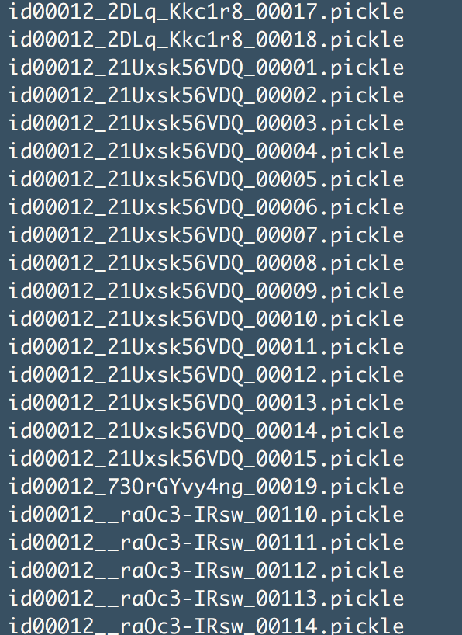
5.3 Pickles and Self-delimiting Formats
Use 'pickle' to store data in deep learning.

Slide 25
5.4 XML and JSON
If you want to design a protocol that supports other programming languages, or just want to use a common standard, then you can use JSON and XML data.
Both types of data do not support frame closure. Therefore, before processing network data, you must use some method to extract the complete text string.
JSON is one of the best choices for sending data between two different programming languages.
The Python 2.6 standard library provides support for JSON and is packaged in the json module. JSON is represented by a string. And JSON doesn't just support Unicode characters in strings. If you tell Python's json module that you don't need to limit the output characters to the ASCII character table, you can even include the literal value of Unicode characters in the data.
import json
json.dump(s)
json.load(s)

Slide 26
5.4 XML and JSON
For documents, the XML format is more practical.
The reason is that its basic structure is to encapsulate the string as an element contained in angle brackets and label them. And don't just limit XML to the HTTP protocol.
Common XML programming interfaces are DOM and SAX. These two interfaces handle XML files differently. Of course, the use cases are different.
SAX (simple API for XML )： The Python standard library contains the SAX parser, which uses an event-driven model to process XML files by triggering individual events and parsing user-defined callback functions during parsing XML.
DOM(Document Object Model)： Parse XML data into a tree in memory and manipulate XML through operations on the tree.
Notes:
现在前后端分离的开发模式里，用JSON比较多。

Slide 27
5.4 XML and JSON
Binary Format
Thrift: Thrift is an interface definition language and binary communication protocol used for defining and creating services for numerous languages. It forms a remote procedure call (RPC) framework and was developed at Facebook for "scalable cross-language services development".
Google Protocol Buffer: Protocol buffers are Google's language-neutral, platform-neutral, extensible mechanism for serializing structured data – think XML, but smaller, faster, and simpler. You define how you want your data to be structured once, then you can use special generated source code to easily write and read your structured data to and from a variety of data streams and using a variety of languages.
Notes:
现在前后端分离的开发模式里，用JSON比较多。

Slide 28
5.5 Compression
Data often takes longer to network transmission than CPU preparation time. Therefore, it is very worthwhile to compress before sending.
GNU's zlib is one of the most popular forms of compression on the Internet today. The Python standard library provides support for zlib, and the ability to block frames is a feature of zlib. Reliable data transmission (based on serial number, confirmation retransmission)
Notes:
Nginx方面的配置
用CPU时间换更小空间

Slide 29
5.5 Compression
In general, most protocol designers will set compressed data as an option. And set the frame blocking policy for itself. If you use zlib, then the various conventions will allow us to take full advantage of the stream termination information provided by zlib and automatically detect the end of each compressed stream.
import zlib
Notes:
Nginx方面的配置

Slide 30
5.6 Network Exceptions
Let's talk about network errors and exceptions and how to deal with them. Several common exceptions that occur with sockets are as follows.
OSError： This is the main error that the socket module might throw. Almost any problem that may occur at all stages of network transmission will throw the exception.
socket.gaierror： This exception is thrown when getaddrinfo() cannot find the provided name or service.
socket.timeout： Sometimes we decide to set the timeout parameter for the socket, and we don't want to wait for the completion of the send() or recv() operation forever. This exception is thrown only if the library used has a socket timeout parameter set. Prove that the waiting operation has completed normally and has exceeded the value of the timeout parameter.

Slide 31
5.6 Network Exceptions
Of course, when using Socket-based high-level protocols provided by Python, we can handle raw socket errors directly in code and then convert them to protocol-specific error types.
For example, httplib thinks it's relatively low-level, so when you connect to an unknown hostname, you can see the underlying socket error.
But urllib2 hides the same error and throws a URLError. This may be that urllib2 considers itself to be a clean and neutral system for parsing URLs into documents, so it is desirable to maintain the corresponding semantics.

Slide 32
5.6 Network Exceptions
When we are dealing with network errors, we will encapsulate the exceptions and provide them to other programmers who call the API. Sometimes we will intercept certain exceptions and provide the appropriate information to the end user. The methods used in these two cases are different.
There are two ways to pass a user who uses our API：
The first is to not process, the caller is responsible for handling exceptions, they catch exceptions, and directly output exceptions to reports.
Another way is to encapsulate the network error as our own exception. This will be more developer friendly.

Slide 33
5.6 Network Exceptions
Catching and reporting network exceptions: granular exception handlers and blanket exception handlers
The granular method is to use the try...except statement for each network call, and then print a concise error message in the except clause.
Another method is the blanket exception handler. To use this method, we need to revisit our code to identify the code segment for a specific operation.
The entire program is used to connect to the license server.
All socket operations in this function are used to get the response from the database.
The last part of the code is used for cleaning and closing operations.
The external program then calls these code segments using the try...except statement. Then capture all the FatalError exceptions thrown at the top level of the program and print out an error message. And you can add a command line option to send serious errors to the system's error log.

